Slide 1
Recruitment Data Analysis using Excel
STUDENT NAME: GAYATHRI K S
REGISTER NO: 312209281
DEPARTMENT: B.COM (General )
COLLEGE : Anna Adarsh College for Women

Slide 2
PROJECT TITLE
Employee recruitment Analysis using Excel

Slide 3


AGENDA
Problem Statement
Project Overview
End Users
Our Solution and Proposition
Dataset Description
Modelling Approach
Results and Discussion
Conclusion
3/21/2024 Annual Review

Slide 4

PROBLEM STATEMENT
A typical problem statement could be:
To analyse and optimize the recruitment process by evaluating key metrics such as salary package, required experience of employee, candidate quality . The analysis aims to identify the proper candidate and recommend strategies to improve the efficiency and effectiveness of the hiring process.

Slide 5

PROJECT OVERVIEW
.
The primary goal of this project is to analyse the recruitment process analysis using excel. This analysis will identify performance indicators , gender category , hiring efficiency , candidate details etc.,

Slide 6

WHO ARE THE END USERS?
The end users are the individuals or groups within the organisation who will utilize the insights, reports , and data produced by the analysis to make informed decisions .

Slide 7

OUR SOLUTION AND ITS VALUE PROPOSITION
Filtering
CHATS – visualization, reports
Pivot table – summary
Conditional Techniques
Bar graph

Slide 8
Dataset Description
Recruitment dataset- kaggle
26 features
9 features
App id
Name –text
Gender – f ,m
Year of exp. - numeric
Salary - numeric
Status - text

Slide 9

THE "WOW" IN OUR SOLUTION
Interactive dynamic filtering
KPI(key performance indicator) – using conditional formatting
Performance level – using IF formula
3/21/2024 Annual Review
9

Slide 10
MODELLING
Data Collection and Preparation.
Gathering Relevant Data:
Candidate Information: Name, Gender, Experience, Application Status and year of experience and performance level using Kaggle.
Data Cleaning:
Ensure all data is clean, consistent, and complete. Use Excel’s Remove Duplicates, Find & Replace, and Data Validation tools to standardize entries.
Data Structuring:
Organize the data in a structured format, typically in a tabular form where each row represents a candidate, and columns represent attributes and metrics.
10

Slide 11
Visualization and Reporting.
Recruitment Dashboard :
Building an interactive dashboard using Excel’s Pivot Tables, Slicers, and Charts to visualize key metrics
KPI Indicators :
Using conditional formatting to highlight key performance indicators (KPIs), such as red ,green color coding for status column.
Automation and Advanced Features :
Dynamic Models :
Implementing dynamic data models using Excel’s Power Query to pull in and refresh data from multiple sources, ensuring that our analysis is always based on the most current information.

Slide 12
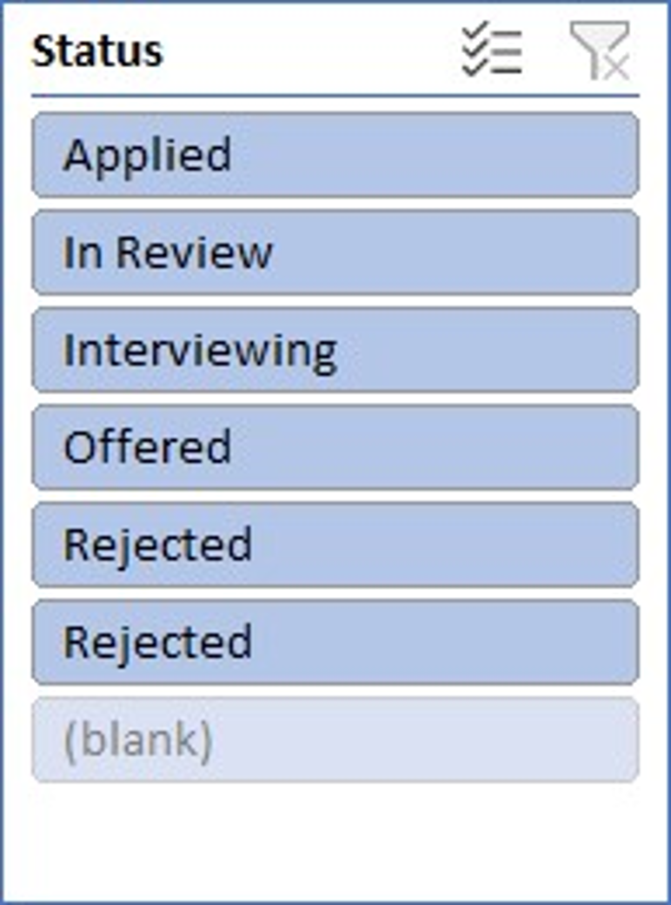
RESULTS
Row Labels | Sum of Years of Experience
HIGH | 28423
Applied | 5704
In Review | 5445
Interviewing | 5624
Offered | 5771
Rejected | 5859
Rejected | 20
LOW | 1471
Applied | 305
In Review | 247
Interviewing | 337
Offered | 328
Rejected | 254
(blank)
(blank)
Grand Total | 29894
12

Slide 13
conclusion
The recruitment analysis conducted using Excel provides a powerful, data-driven approach to understanding and optimizing the hiring process. By leveraging Excel's robust capabilities in data management, statistical analysis, and visualization, we have been able to uncover key insights into the efficiency and effectiveness of the recruitment efforts.

